Slide 1
Introduction to computer vision
Session 1

Slide 2
What is computer vision?
It is defined as a scientific field that extracts information out of digital images.
Another way to define computer vision is through its applications. Computer vision is building algorithms that can understand the content of images and use it for other applications.
Other Definitions:
The construction of explicit, meaningful descriptions of physical objects from images (Ballard & Brown, 1982)
Computing properties of the 3D world from one or more digital images (Trucco & Verri 1998)
To make useful decisions about real physical objects and scences based on sensed images (sockman & shapiro, 2001)

Slide 3
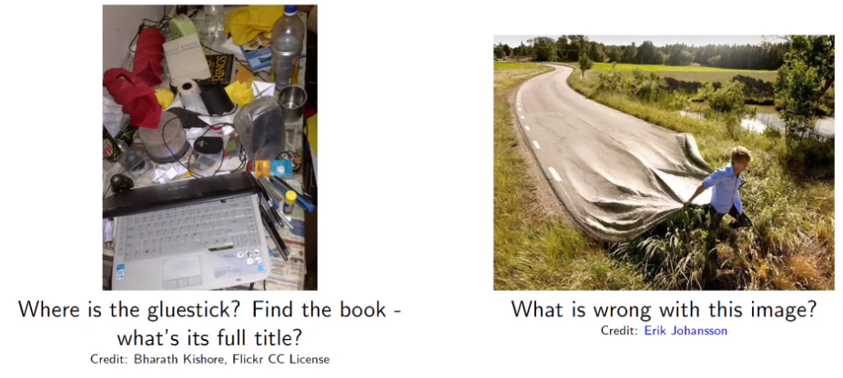
Example
Can a machine can answer this questions?

Slide 4
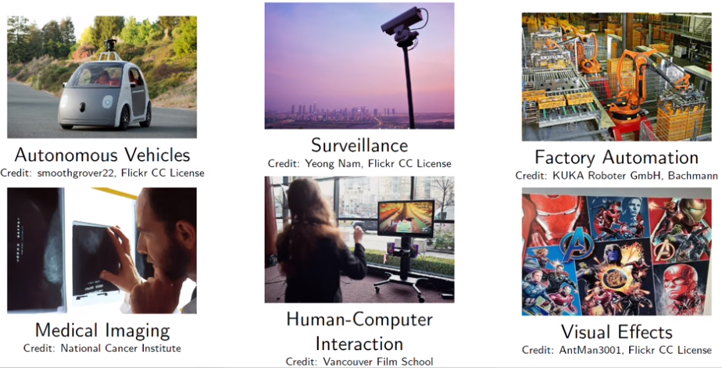
Why ? Applications of CV

Slide 5
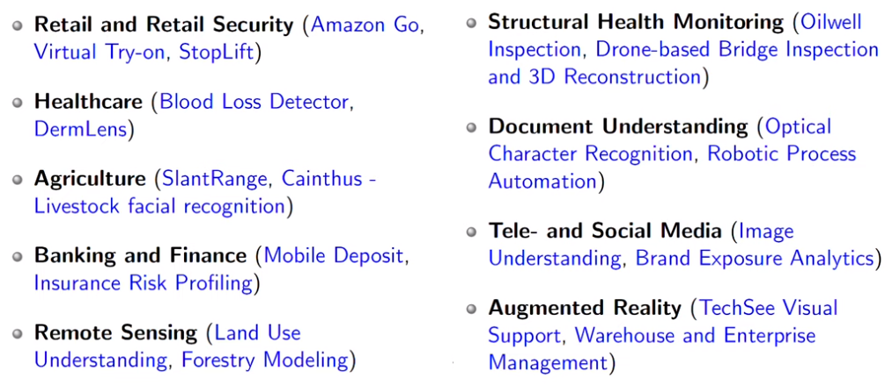
Other Applications

Slide 6
Videos
Amazon Go - https://www.youtube.com/watch?v=NrmMk1Myrxc
DRONE for Bridge Inspection - https://www.youtube.com/watch?v=A-8lmUIv4TE

Slide 7
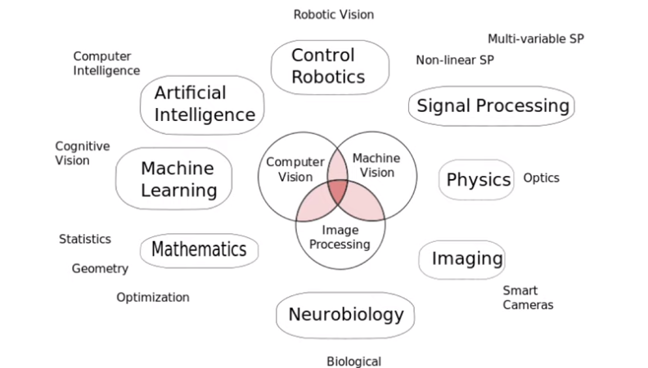
Perspective of study

Slide 8
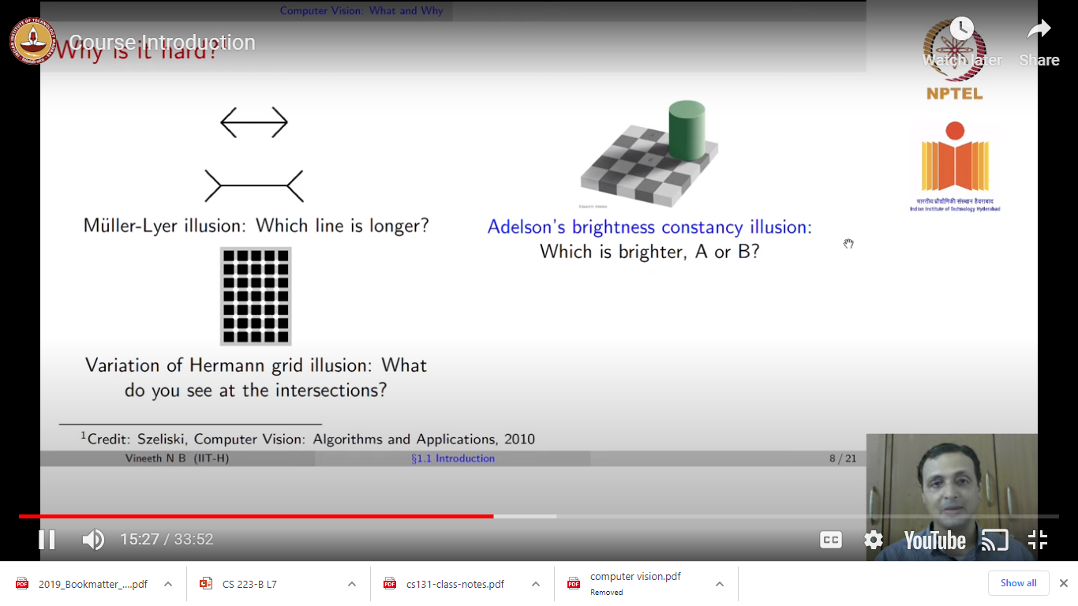
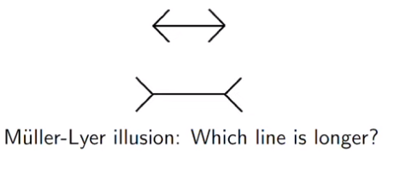
Why it is hard?

Slide 9
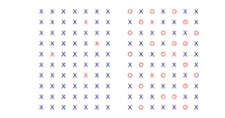
Count X’s in this image?

Slide 10
Why it is hard?
Many practical use cases are inverse model applications
No knowledge of how an image was taken or camera parameters. But need to model the real world in which picture/video was taken (shape, lighting, color, objects, interactions). → Need to almost always model from incomplete/partial noisy information
Forward models are used in physics (radiometry, optics and sensor design) and in computer graphics
High dimensional data → heavy computational requirements.

Slide 11
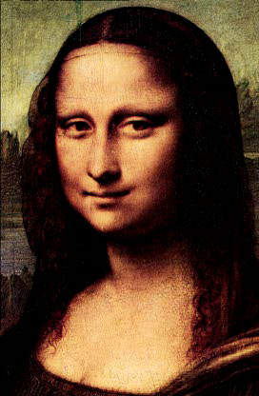
Pixel or pel – Picture element
5 x 5 image

Slide 12
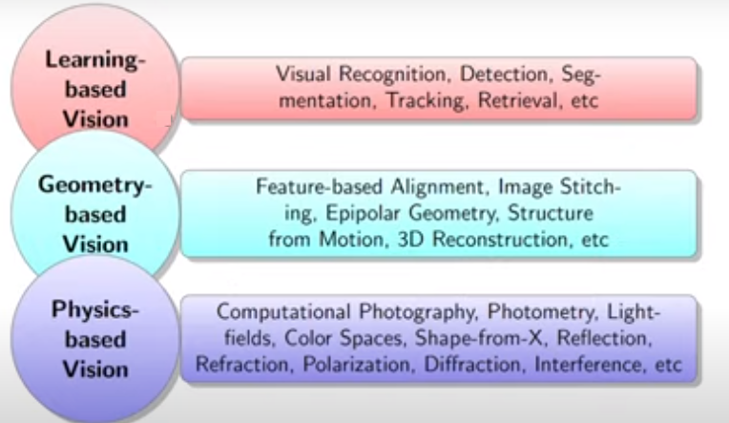
Three types of vison

Slide 13
History (Group Discussion)

Slide 14
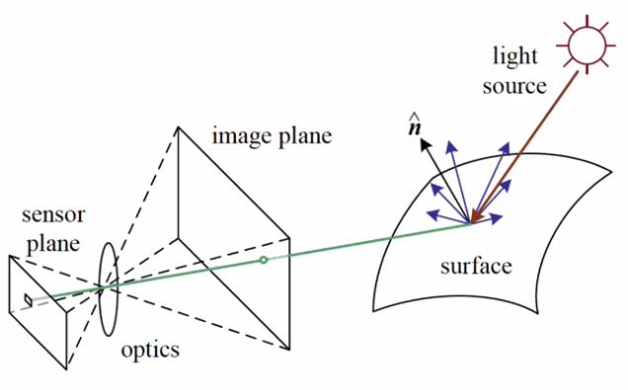
Image formation
Factors:
Light source strength and direction
Surface geometry, material and nearby surfaces
Sensor capture properties
Image representation and colour

Slide 15
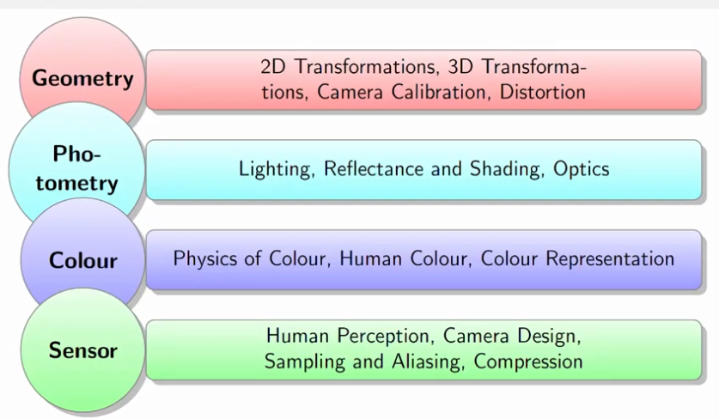
Topics

Slide 16
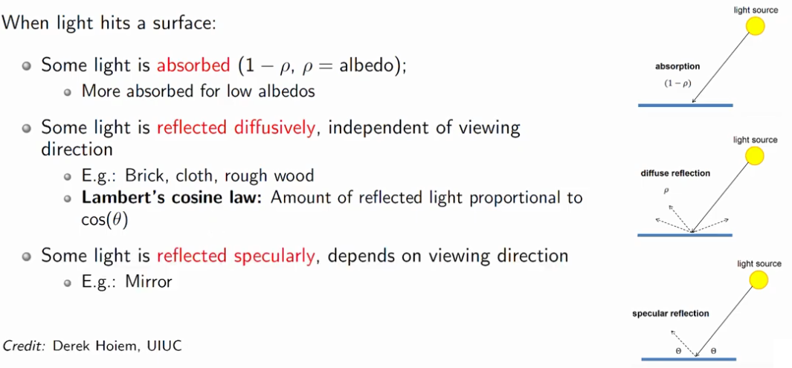
Models of Reflection

Slide 17
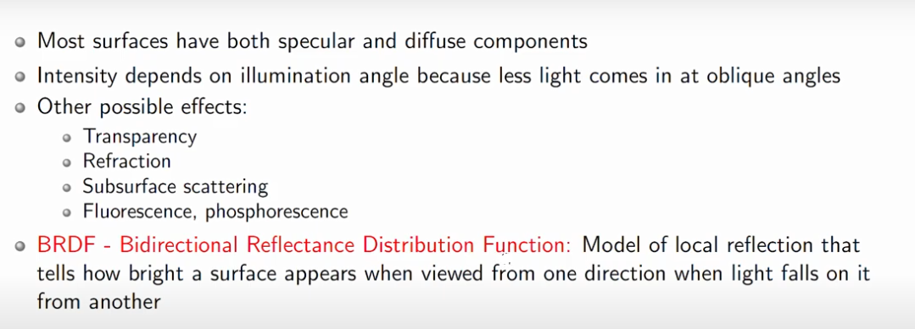
Models of Reflection

Slide 18
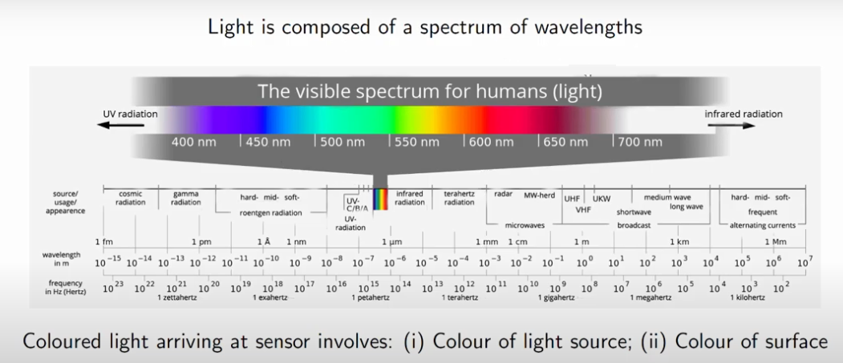
Colour

Slide 19
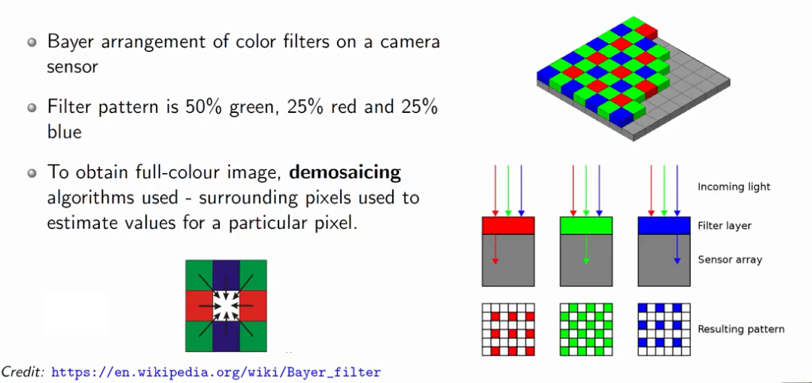
Bayer Grid / Filter

Slide 20
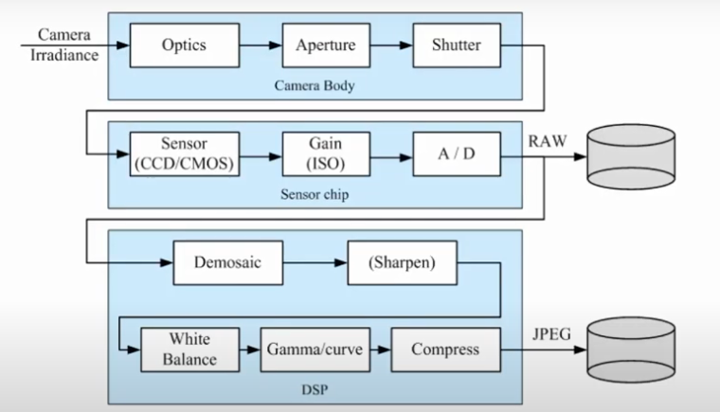
Image Pipeline Capture

Slide 21
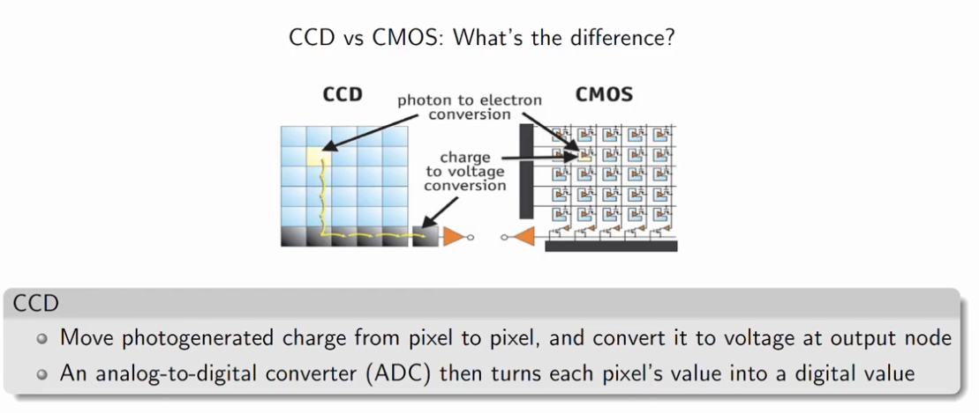
Digital Image Sensing (Charge Coupled Device)

Slide 22
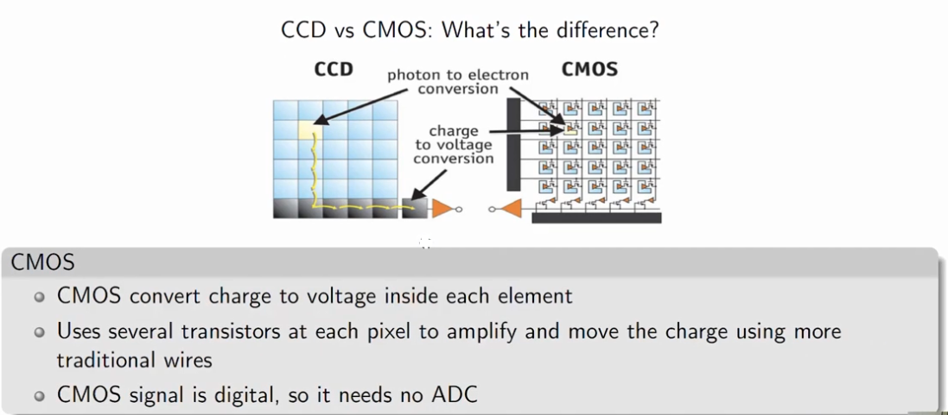
Digital Image Sensing (Complementary Metal Oxide Semiconductor)

Slide 23
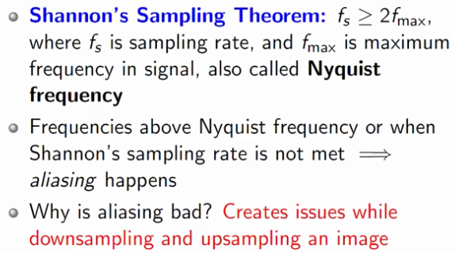
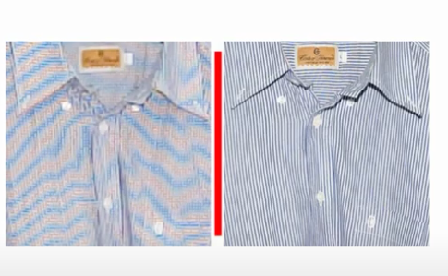
Sampling & Aliasing

Slide 24
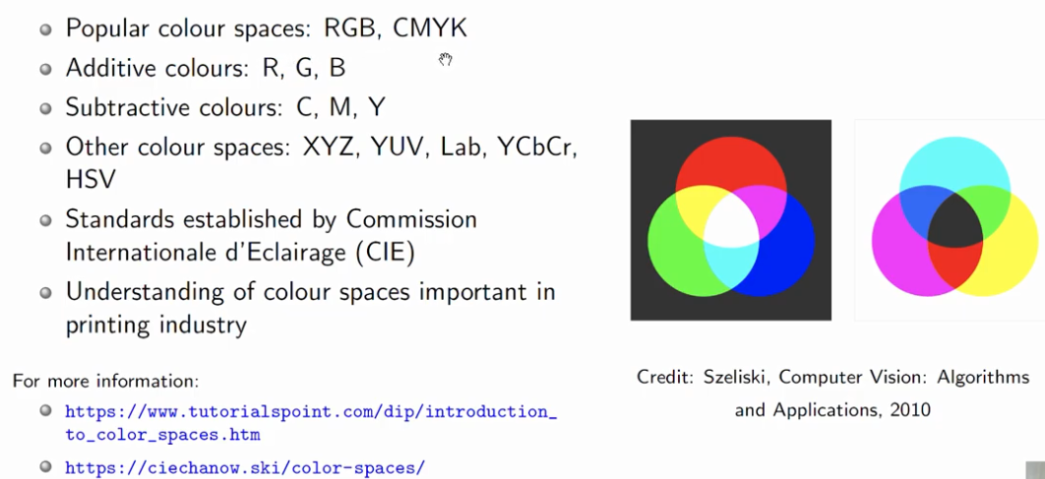
Colour Space Representations
cyan, magenta, yellow and black - CMYK – printer
Family of color spaces used as a part of the color image pipeline in video and digital photography systems - YCbCr

Slide 25
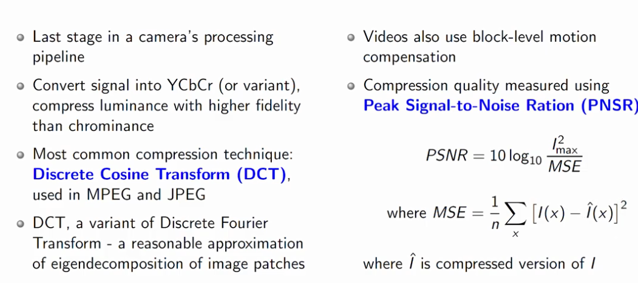
Image Compression

Slide 26
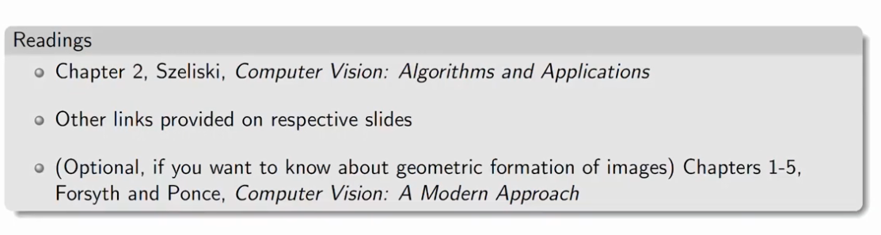
References

Slide 27
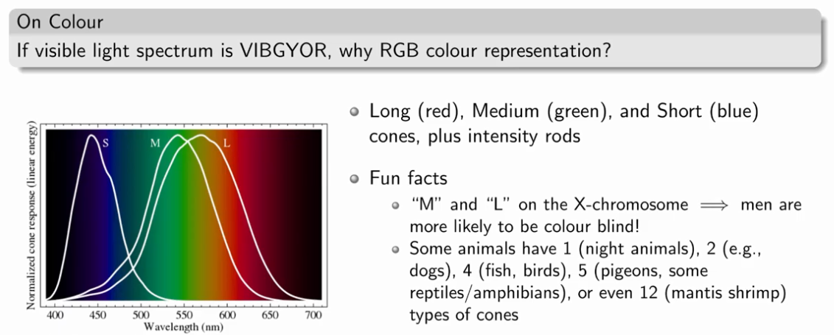
Image Representation

Slide 28
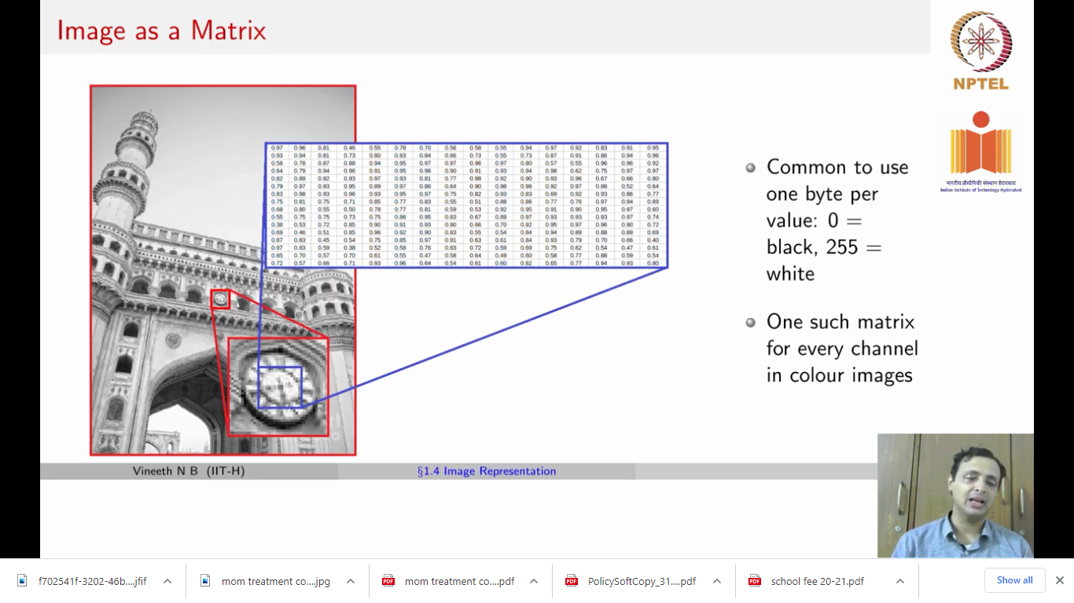
Image as a Matrix
Common to use one byte per value : 0 = black, 255 = white
One such matrix for every channel in color images

Slide 29
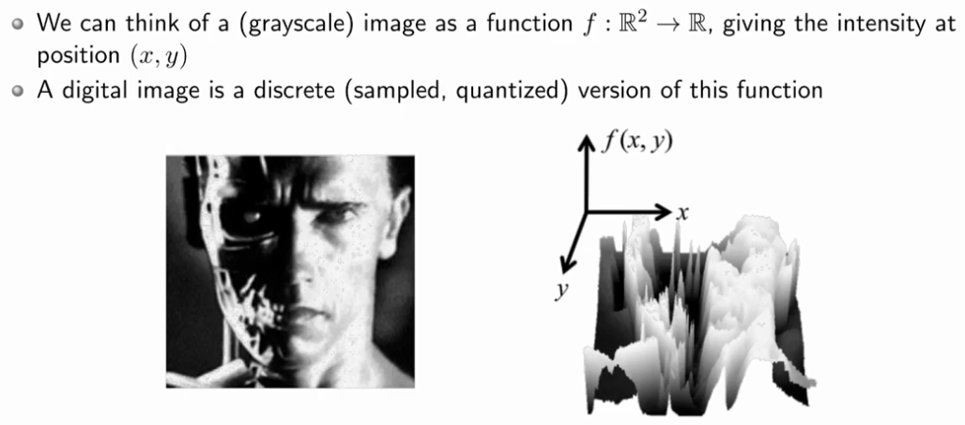
Image as a Function
R² ⁻ particular pixel (x,y) → Intensity

Slide 30
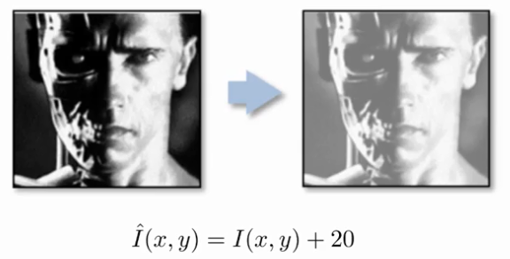
Image Transform (Increasing the contrast)

Slide 31
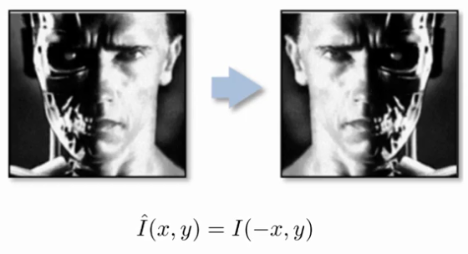
Image Transform (Flipping the image)

Slide 32
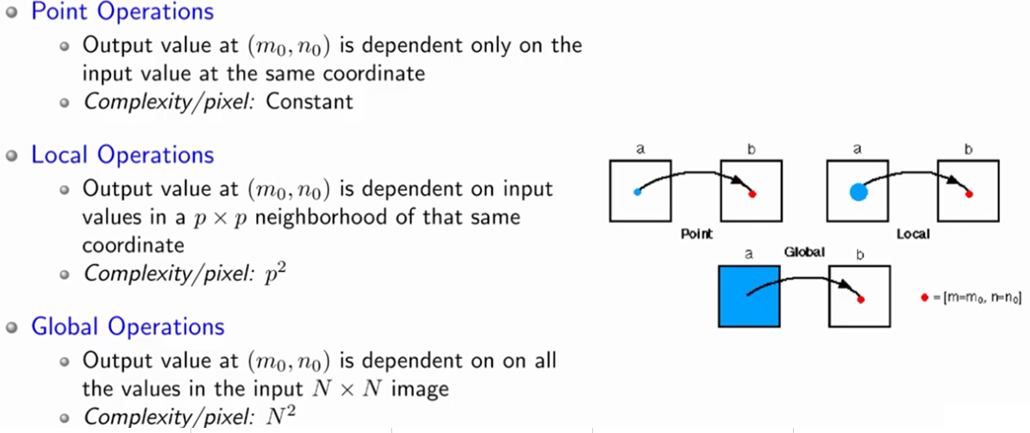
Image Professing Operations

Slide 33
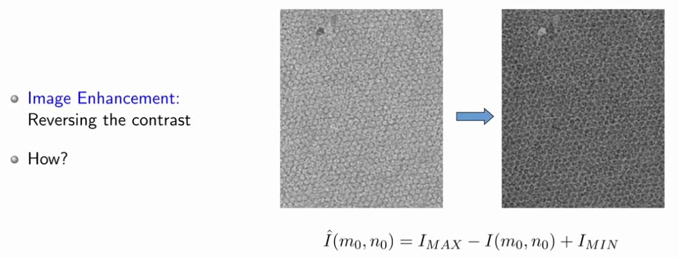
Point Operation - Example

Slide 34
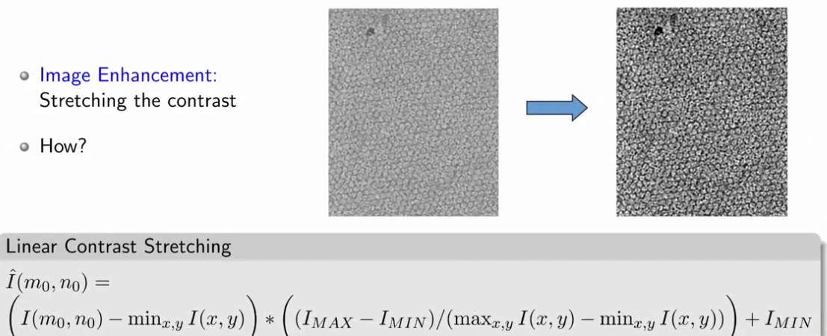
Example 2
Min = 100; max = 200;

Slide 35
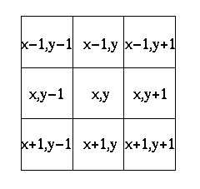
Local Operations – Example (Moving Average)
0 | 0 | 0 | 0 | 0 | 0 | 0 | 0 | 0 | 0
0 | 0 | 0 | 0 | 0 | 0 | 0 | 0 | 0 | 0
0 | 0 | 0 | 90 | 90 | 90 | 90 | 90 | 0 | 0
0 | 0 | 0 | 90 | 90 | 90 | 90 | 90 | 0 | 0
0 | 0 | 0 | 90 | 90 | 90 | 90 | 90 | 0 | 0
0 | 0 | 0 | 90 | 90 | 90 | 90 | 90 | 0 | 0
0 | 0 | 0 | 90 | 90 | 90 | 90 | 90 | 0 | 0
0 | 0 | 0 | 0 | 0 | 0 | 0 | 0 | 0 | 0
0 | 0 | 90 | 0 | 0 | 0 | 0 | 0 | 0 | 0
0 | 0 | 0 | 0 | 0 | 0 | 0 | 0 | 0 | 0
1 | 1 | 1
1 | 1 | 1
1 | 1 | 1
Window can be any size of N x N
Coordinates of pixel (8 neighbor)

Slide 36
Installing OpenCV in pycharm IDE
Step 1: Open Pycharm IDE
Step 2: File → goto setting→ select your project→python interpreter→ Click “+” to install the package → in search type opencv python and install it
Another method
The straightforward installation process of openCV can be done by using the following command in the command prompt.
pip install opencv-python
In anaconda → command prompt
conda install -c conda-forge opencv

